Slide 1
Centralised Digital Platform for Comprehensive student activity record in Higher Education Institutions (HEIs)
CSE7302 - Capstone Project
Review-2
Batch Number: CSE_151
Under the Supervision of,
Guide: Ms. Riya Sanjesh
(Computer Science and Engineering)
Presidency University
Roll Number | Student Name
20221CSE0005 | Kothareddy Vamshidhar Reddy
20221CSE0044 | Abhiram PB
20221CSE0276 | Akanksha Bhartiya
Name of the Program: CSE 7101 Capstone Project (Semester VIII)
Name of the HoD: Dr. Asif Mohammed , Dr. Blessed Prince
Name of the Program Project Coordinator: Dr. Jayavadivel Ravi, Mr. Muthuraju V
Name of the School Project Coordinators: Dr. Sampath A K , Dr. Geetha A

Slide 2
Problem Statement Number: SIH25093
Organization: Government of Jammu and Kashmir
Category (Hardware / Software / Both) : Software
Problem Description:
There is currently no unified digital system that allows Higher Education Institutions to systematically capture, verify, track, and present a student’s complete academic and non-academic record throughout their academic tenure. Students lack a credible, verified digital profile that can support placements, higher education admissions, scholarships, and skill recognition. Faculty and administrators face additional workload due to repetitive documentation, manual validation, and report generation.

Slide 3
Content
Problem Statement
Objectives
Research Papers for Literature Survey
Analysis of Relevant Research Papers
Background and Related work for title Selection
Analysis of Problem Statement
Innovation or Novel Contributions
Git-hub Link
Timeline of the Project
References

Slide 4
Problem Statement
Higher Education Institutions (HEIs) currently store student academic and non-academic records across multiple systems, departments, and paper files. Important data such as workshops, certifications, internships, competitions, club activities, and community service is not maintained in a single verified system.
Because of this:
Students do not have a complete digital profile
Faculty and administrators spend extra time on manual verification
Institutions face difficulties during NAAC, AICTE, and NIRF reporting
There is a strong need for a centralized, secure, and verified digital platform that maintains the complete student lifecycle from admission to graduation.

Slide 5
Objectives
Digitize and centralize academic and co-curricular student records
Create a verified student profile from the time of admission
Reduce dependency on paper-based documentation
Enable faculty to monitor and mentor students effectively
Support fast and accurate accreditation reporting
Prepare students with verified profiles for placements and higher studies

Slide 6
Research Papers for Literature Survey
[1] R. Barrett, “E-Portfolios: Digital Stories of Deep Learning,” Educause Review, vol. 45, no. 4, pp. 18–30, 2010. Available: https://www.researchgate.net/publication/228350576_E-Portfolios_Digital_Stories_of_Deep_Learning
[2] H. Challis, “Towards the Mature ePortfolio: Some Implications for Higher Education,” Canadian Journal of Learning and Technology, vol. 31, no. 3, 2005. Available: https://www.researchgate.net/publication/228623407_Towards_the_mature_ePortfolio
[3] J. Abrami and H. Barrett, “Directions for Research and Development on Electronic Portfolios,” Canadian Journal of Learning and Technology, vol. 31, no. 3, 2005. Available: https://www.researchgate.net/publication/228709146_Directions_for_Research_and_Development_on_Electronic_Portfolios
[4] S. Lorenzo and J. Ittelson, “An Overview of E-Portfolios,” EDUCAUSE Learning Initiative, no. 1, 2005. Available: https://www.researchgate.net/publication/242720694_An_Overview_of_E-Portfolios
[5] A. Koraneekij and S. Khlaisang, “Development of an Outcome-Based Learning System Using e-Portfolios,” International Journal of Emerging Technologies in Learning (iJET), vol. 14, no. 11, pp. 208–223, 2019. Available: https://www.researchgate.net/publication/333946389

Slide 7
Research Papers for Literature Survey
[6] M. C. Chen, Y. M. Huang, and S. H. Cheng, “Developing a Student Learning Performance Evaluation System Using Data Analytics,” Educational Technology & Society, vol. 20, no. 2, pp. 192–204, 2017. Available: https://www.researchgate.net/publication/315870125
[7] P. D. Leahy and A. Tsang, “Digital Credentialing and Student Records Management in Higher Education,” Journal of Educational Administration, vol. 56, no. 4, pp. 425–442, 2018. Available: https://www.researchgate.net/publication/326532941
[8] S. B. Shukla and R. Mishra, “Web-Based Student Information Management System for Academic Institutions,” International Journal of Computer Applications, vol. 120, no. 15, pp. 1–6, 2015. Available: https://www.researchgate.net/publication/280009402
[9] A. Alammary, S. Alhazmi, M. Almasri, and S. Gillani, “Blockchain-Based Applications in Education: A Systematic Review,” Applied Sciences, vol. 9, no. 12, p. 2400, 2019. Available: https://www.researchgate.net/publication/333365505
[10] M. J. Beetham and R. Sharpe, Rethinking Pedagogy for a Digital Age, 2nd ed., Routledge, 2013. Available: https://www.researchgate.net/publication/263984640

Slide 8
Analysis of Relevant Research Papers
Development of Student Performance Tracking Apps (Kumbhar & Patil, 2020)
What the Paper is About: This paper focuses on the creation of mobile-based applications to track student academic performance such as marks, attendance, and progress reports. The authors highlight the need for digital systems to replace manual monitoring methods and improve transparency between students and faculty.
The Methodology They Used: The system proposed in this paper follows a traditional application-based tracking approach:
Collection of academic data (marks, attendance, test scores)
Storage of records in a centralized database
Display of performance reports through dashboards
Role-based access for students and teachers
The focus is mainly on academic performance metrics, with limited scope beyond classroom-related data.
How Their Approach is Different from Ours: While this research focuses only on academic tracking, Smart Student Hub extends beyond academic data. Our system integrates co-curricular, extra-curricular, internships, certifications, and community activities into the same verified profile. Additionally, Smart Student Hub introduces faculty approval workflows and portfolio generation, which are not addressed in this paper.

Slide 9
Analysis of Relevant Research Papers
2. Student’s Digital Portfolio for Assessing and Presenting Talents (Alqahtani, 2020)
What the Paper is About: This research explores the use of digital portfolios as a tool for students to present their skills, achievements, and talents. The paper emphasizes portfolios as a self-representation mechanism that supports assessment, reflection, and skill showcasing.
The Methodology They Used: The proposed approach includes:
Student-driven content submission (projects, achievements, skills)
Use of digital artifacts such as documents and multimedia
Portfolio-based assessment for evaluating student abilities
Emphasis on learner ownership and presentation
The portfolio is primarily student-managed, with minimal institutional validation.
How Their Approach is Different from Ours: Smart Student Hub builds upon the idea of digital portfolios but adds institution-level credibility. Unlike the student-managed portfolios in this paper, our system introduces faculty and administrator verification, ensuring that all records are authentic and officially approved. Furthermore, Smart Student Hub supports auto-generated, accreditation-ready portfolios, making them usable for placements, scholarships, and higher education.

Slide 10
Analysis of Relevant Research Papers
3. The Contribution of Digital Portfolios to Higher Education Students’ Autonomy and Digital Competence (González-Calatayud et al., 2023)
What the Paper is About: This study investigates how digital portfolios contribute to student autonomy, reflective learning, and digital skill development in higher education. It highlights portfolios as tools that encourage responsibility, self-monitoring, and continuous improvement.
The Methodology They Used: The researchers used:
Portfolio-based learning activities
Student reflection and self-assessment
Surveys and qualitative analysis to measure autonomy and competence
Long-term observation of student engagement
The emphasis is on learning outcomes and skill development, rather than administrative or institutional use.
How Their Approach is Different from Ours: While this paper focuses on personal growth and learning autonomy, Smart Student Hub applies digital portfolios at an institutional scale. Our system connects portfolios with faculty validation, analytics, and structured reporting, supporting not only student development but also administrative efficiency and compliance needs such as NAAC, AICTE, and NIRF reporting.

Slide 11
Background and Related Work
This project lies in the Educational Technology (EdTech) domain, focusing on managing student academic and co-curricular records in Higher Education Institutions.
Existing systems such as ERP and LMS handle marks, attendance, and learning content, but they do not capture a student’s full development. Records related to internships, certifications, events, clubs, and community service are usually stored in separate tools or physical files.
Research Gap
There is no unified platform that connects academic and non-academic records with faculty verification and portfolio generation. This gap limits transparency, student visibility, and institutional efficiency.
Title Justification
The title “Smart Student Hub” reflects a centralized system that connects students, faculty, and administrators for complete and verified student record management.

Slide 12
Analysis of Problem Statement (contd...)
Existing Solutions
Most institutions depend on:
ERP systems for marks and attendance
LMS platforms for course delivery
Manual records or isolated tools for co-curricular and extra-curricular activities
These systems work in isolation and do not provide a unified or verified view of a student’s overall development.
Limitations Identified
Academic and non-academic records are not linked
Absence of a centralized student profile
Lack of faculty validation reduces record reliability
Manual data compilation for NAAC, AICTE, and NIRF reporting
Students lack a credible portfolio for placements and higher studies

Slide 13
Analysis of Problem Statement (contd...)
Software Requirements:
IDE: Visual Studio Code
Runtime Environment: Node.js (v18.x or later)
Frontend: Next.js (TypeScript), Tailwind CSS
Backend: MongoDB Server / MongoDB Atlas (Cloud)
Email Service: Brevo API
Authentication: JWT (HttpOnly cookies), bcrypt
API Testing: Postman
Design & Prototyping: Figma
Version Control: Git/Github
Hardware Requirements:
No specialized hardware is required. A standard developer laptop with at least 8GB RAM and an internet connection is sufficient for development and deployment.

Slide 14
Analysis of Problem Statement
Smart Student Hub addresses these gaps by offering a centralized, verified, and role-based platform that manages the full student lifecycle.
The chosen technology stack directly supports this goal:
Next.js (TypeScript, Tailwind CSS) enables a fast, responsive dashboard for students and faculty
MongoDB / MongoDB Atlas allows flexible storage of diverse academic and activity records
JWT-based authentication with HttpOnly cookies and bcrypt ensures secure access and data integrity
Brevo Email API supports secure onboarding and record-related notifications
Postman and Git/GitHub support reliable development and collaboration
Figma enables clear UI design for usability across users
Existing solutions store data in silos, whereas Smart Student Hub integrates, verifies, and presents student achievements in a single platform. By using a modern, scalable, and secure technology stack, the system reduces administrative effort, improves transparency, and prepares students with verified profiles for academic and professional growth.

Slide 15
Proposed Method & Feasibility Study
Proposed Method
Multi-tenant system using AISHE-based isolation
FastAPI + MongoDB + Next.js architecture
JWT-based role authentication
Strict role-based access control
University context resolved server-side only
Secure document storage via GridFS
Modular design for scalability
Feasibility Study
Technically feasible using proven open-source stack
Operationally efficient with role-specific dashboards
Cost-effective (no licensing, low infrastructure cost)
Scalable for multiple universities and future expansion

Slide 16
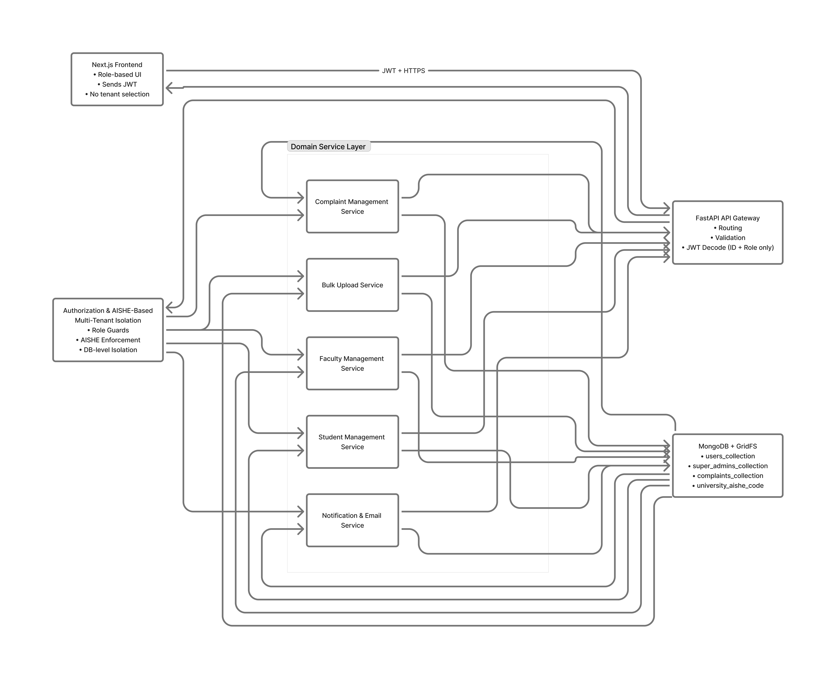
Architecture Diagram

Slide 17
Innovation or Novel Contributions
Unified Student Profile System Introduces a single digital profile that combines academic performance with co-curricular and extra-curricular achievements across the entire student lifecycle.
Faculty-Verified Activity Records Adds a structured faculty/admin approval workflow to validate student-submitted activities, improving data credibility and trust.
Auto-Generated Digital Portfolios Enables students to generate verified portfolios in PDF or shareable link format for placements, scholarships, and higher studies.
Accreditation-Ready Analytics Provides institution-level analytics and structured reports tailored for NAAC, AICTE, and NIRF requirements, reducing manual reporting effort.
Role-Based, Secure Access Model Implements role-specific dashboards (Student, Faculty, Admin) with secure authentication to protect sensitive academic data.
Flexible and Scalable Architecture Designed using modern web technologies to support easy integration with existing ERP, LMS, and digital university platforms.

Slide 18
Github Link
The Github link provided should have public access permission.
Github Link
https://github.com/akanksha0322/CapstoneProject_CSE_151_SmartStudentHub

Slide 19
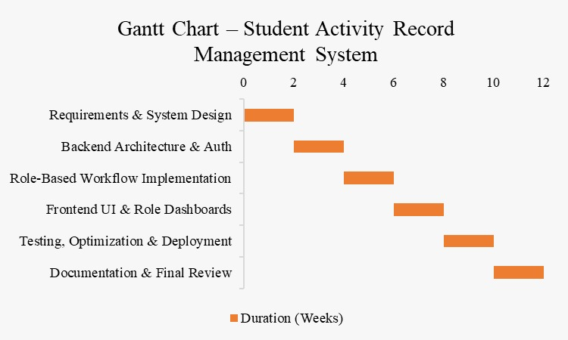
Timeline of the Project (Gantt Chart)

Slide 20
References (IEEE Paper format)
[1] S. R. Kumbhar and P. R. Patil, “Development of Student Performance Tracking Apps,” International Journal of Innovative Research in Science, Engineering and Technology, 2020. Available: https://www.researchgate.net/publication/338342446_Development_of_Student_Performance_Tracking_Apps
[2] M. Alqahtani, “Student’s Digital Portfolio for Assessing and Presenting Talents,” International Journal of Emerging Technologies in Learning (iJET), 2020. Available:https://www.researchgate.net/publication/347529504_Student%27s_Digital_Portfolio_for_Assessing_and_Presenting_Talents
[3] M. González-Calatayud, J. Prendes-Espinosa, and P. Roig-Vila, “The Contribution of Digital Portfolios to Higher Education Students’ Autonomy and Digital Competence,” Education Sciences, vol. 13, no. 8, p. 829, Aug. 2023, doi: 10.3390/educsci13080829. Available: https://www.researchgate.net/publication/373127588_The_Contribution_of_Digital_Portfolios_to_Higher_Education_Students%27_Autonomy_and_Digital_Competence
[4] J. L. D. Silva, R. L. Santos, and A. P. Costa, “Mixed-Method Study of Utilizing Portfolios to Document and Assess Co-Curricular Activities: Student and Advisor Perceptions,” Journal of Educational Technology Systems, 2019. Available: https://www.researchgate.net/publication/338048191_Mixed-Method_Study_of_Utilizing_Portfolios_to_Document_and_Assess_Co-Curricular_Activities_Student_and_Advisor_Perceptions
[5] A. Sharma and R. Verma, “Review on Student Activities Monitoring System,” International Journal for Research in Applied Science & Engineering Technology (IJRASET), 2024. Available: https://www.researchgate.net/publication/389430770_Review_on_Student_Activities_Monitoring_System

Slide 21


